Slide 1
Cloud computing

Slide 2
Grid computing
Grid computing is a group of computers physically connected (over a network or with Internet)
to perform a dedicated tasks together, such as analyzing e-commerce data and solve a complex problem.
Grids are a form of “super virtual computer” that solve a particular application.
The grid size may vary from small to large enterprises network.
A computing grid is constructed with the help of grid middle ware software that allows them to communicate.
middle ware is used to translates one node information passed stored or processed information to another into a recognizable format.
It is the form of “distributed computing” or “peer-to-peer computing”.

Slide 3
Cluster computing
Cluster computing defines several computers linked on a network and implemented like an individual entity.
Each computer that is linked to the network is known as a node.
Cluster computing provides solutions to solve difficult problems by providing faster computational speed, and enhanced data integrity.
The connected computers implement operations all together thus generating the impression like a single system (virtual device).
This procedure is defined as the transparency of the system.

Slide 4
Distributed computing
A distributed system allows resource sharing, including software by systems connected to the network.
Examples of distributed systems / applications of distributed computing : Intranets, Internet, WWW, email. Telecommunication networks: Telephone networks and Cellular networks.

Slide 5
Utility computing
Utility computing is the computing handling online resources such as data, services that is familiar to a public utility.
LPG, water, electricity or telephone are examples.
It has the benefit of cheap cost to get computer resources.

Slide 6
Web services
web services include any software, application, or cloud technology that provides standardized web protocols (HTTP or HTTPS) to interoperate, communicate, and exchange data messaging – usually XML (Extensible Markup Language) – throughout the internet.
web services are XML-centered data exchange systems that use the internet for A2A (application-to-application) communication and interfacing.
These processes involve programs, messages, documents, and/or objects.
A key feature of web services is that applications can be written in various languages and are still able to communicate by exchanging data with one another via a web service between clients and servers.

Slide 7
What is Cloud?
The term Cloud refers to a Network or Internet. In other words, we can say that Cloud is something, which is present at remote location.
Cloud can provide services over public and private networks, i.e., WAN, LAN or VPN.
Applications such as e-mail, web conferencing, customer relationship management (CRM) execute on cloud.

Slide 8
What is cloud computing
Cloud Computing refers to manipulating, configuring, and accessing the hardware and software resources remotely.
It offers online data storage, infrastructure, and application.
Cloud computing offers platform independency, as the software is not required to be installed locally on the PC. Hence, the Cloud Computing is making our business applications mobile and collaborative.

Slide 9
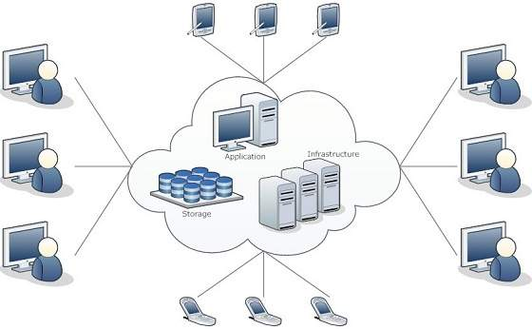
Cloud computing

Slide 10
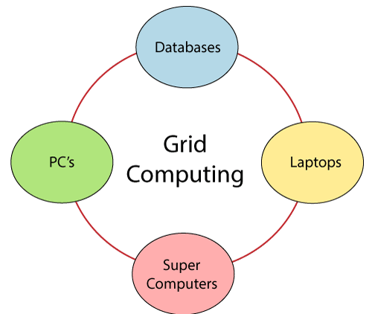

Slide 11
What is cloud computing
On premise
Higher pay less scalability
Allot huge space for servers
Appoint a team for hardware and software maintenance
Poor data security
Less chance of data recovery
Lacks of flexibility
No automatice updates
Less collaboration
Data cannot be accessed remotely
Takes longer implementation time
Cloud computing
Pay for what you use
Scale up=pay more
Scale down=pay less
No server space is required
No experts required for hardware maintenance
Better data security
Disaster recovery
High flexibility
Automatic software update
Teams can collaborate from widespread
Data can be accessed and shared anywhere in the internet
Rapid implementation

Slide 12
What is cloud computing
Cloud computing is the delivery on-demand computing services over the internet on a pay –as –you go basis
Rather than managing files on local storage device,
Cloud computing makes it possible to save them over internet

Slide 13
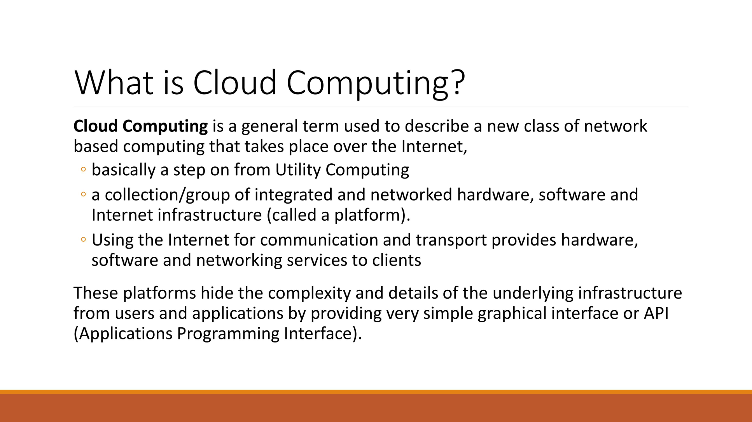

Slide 15
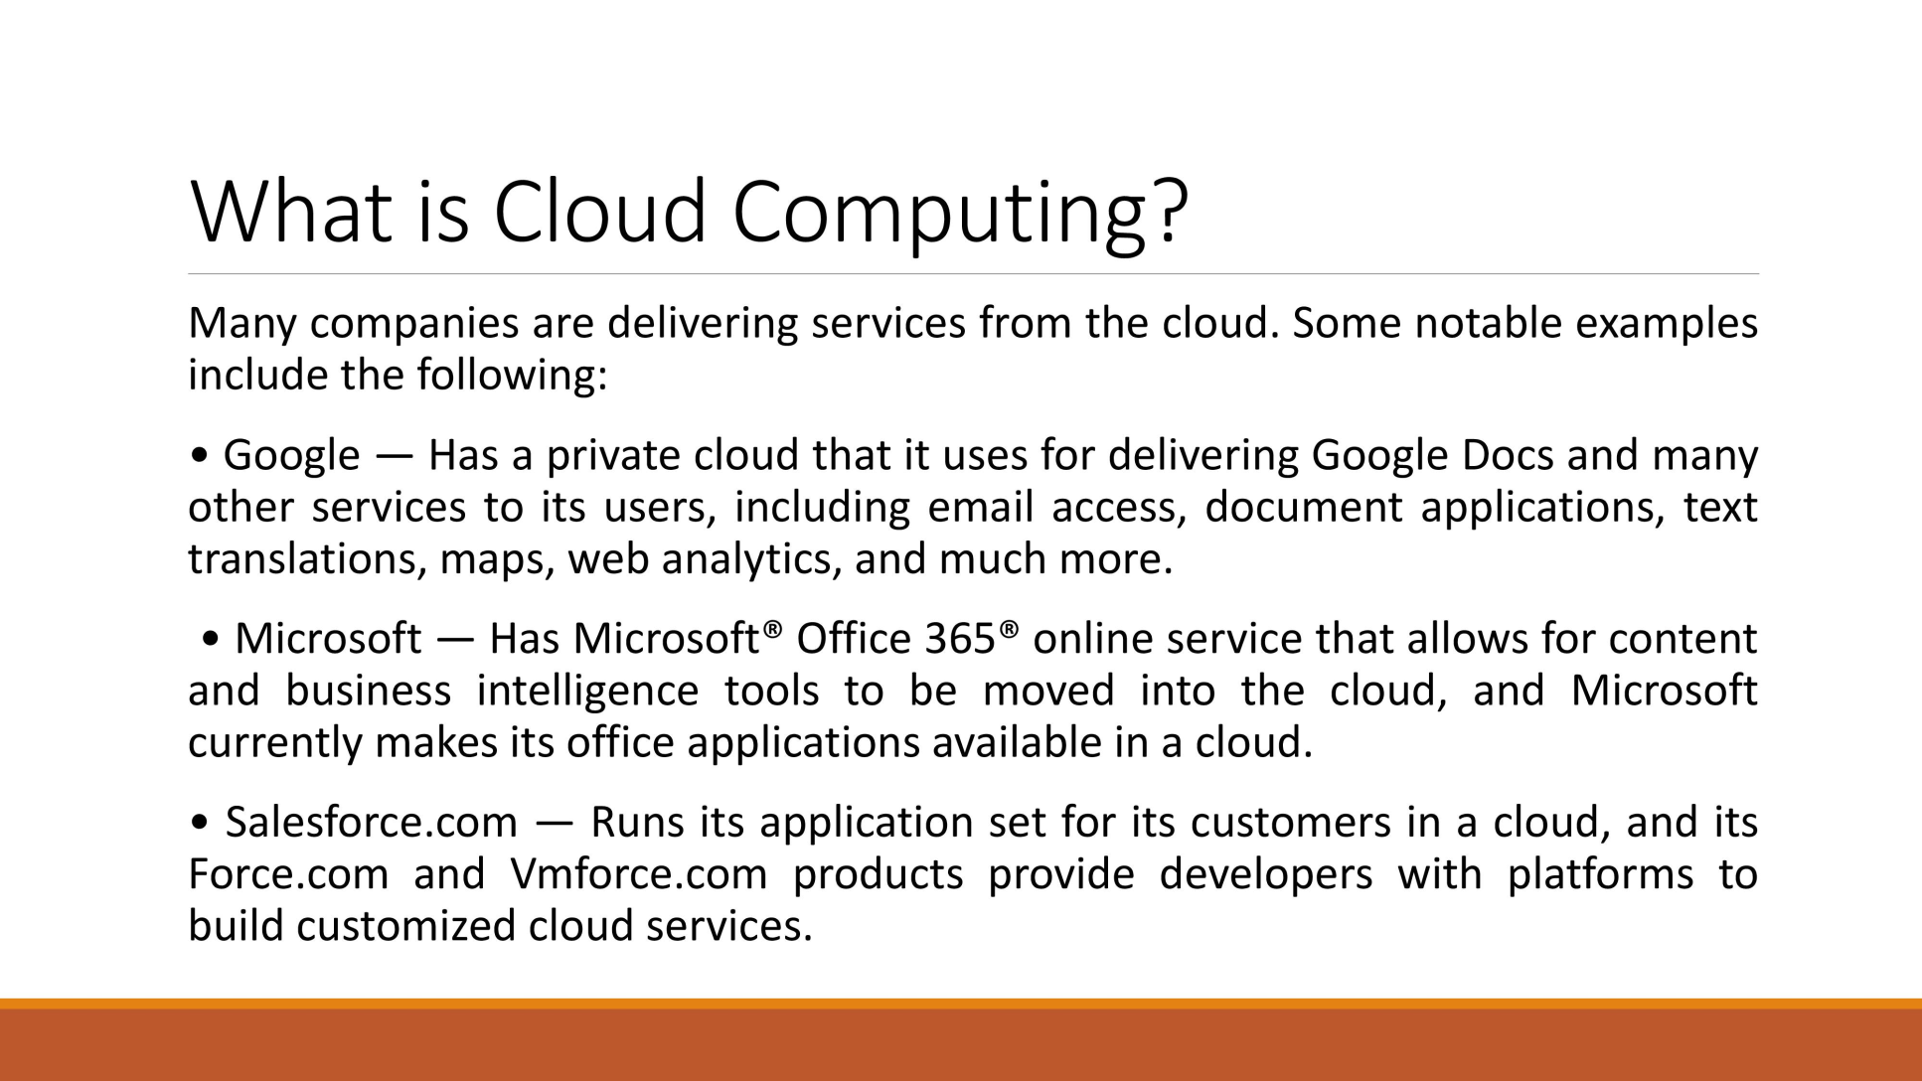
Cloud computing

Slide 16
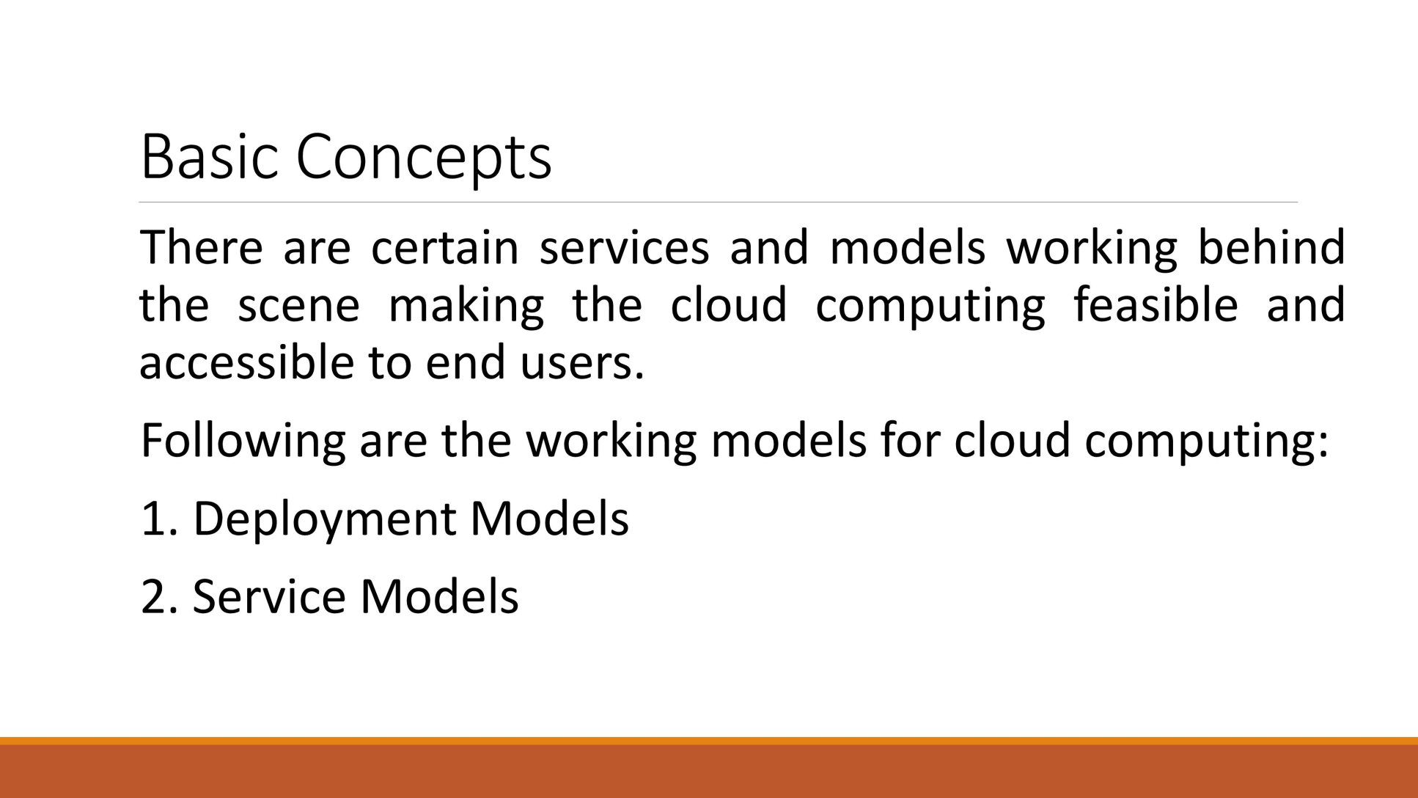
Basic concepts

Slide 17
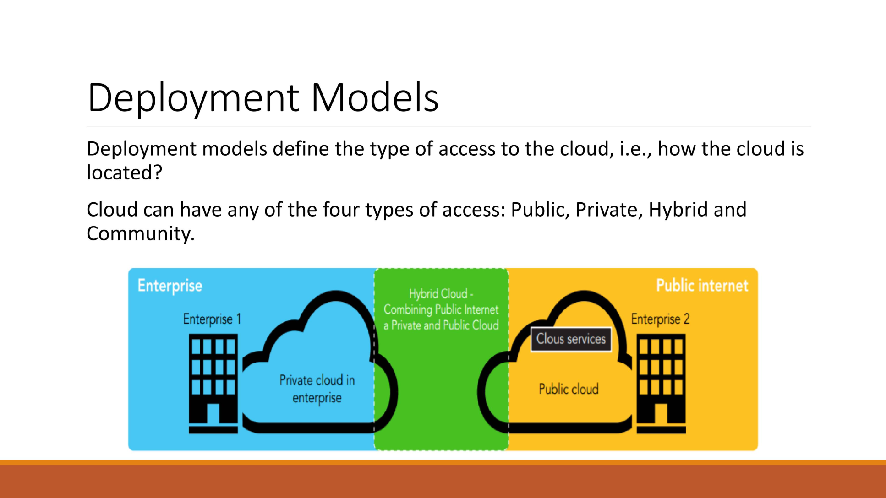

Slide 18
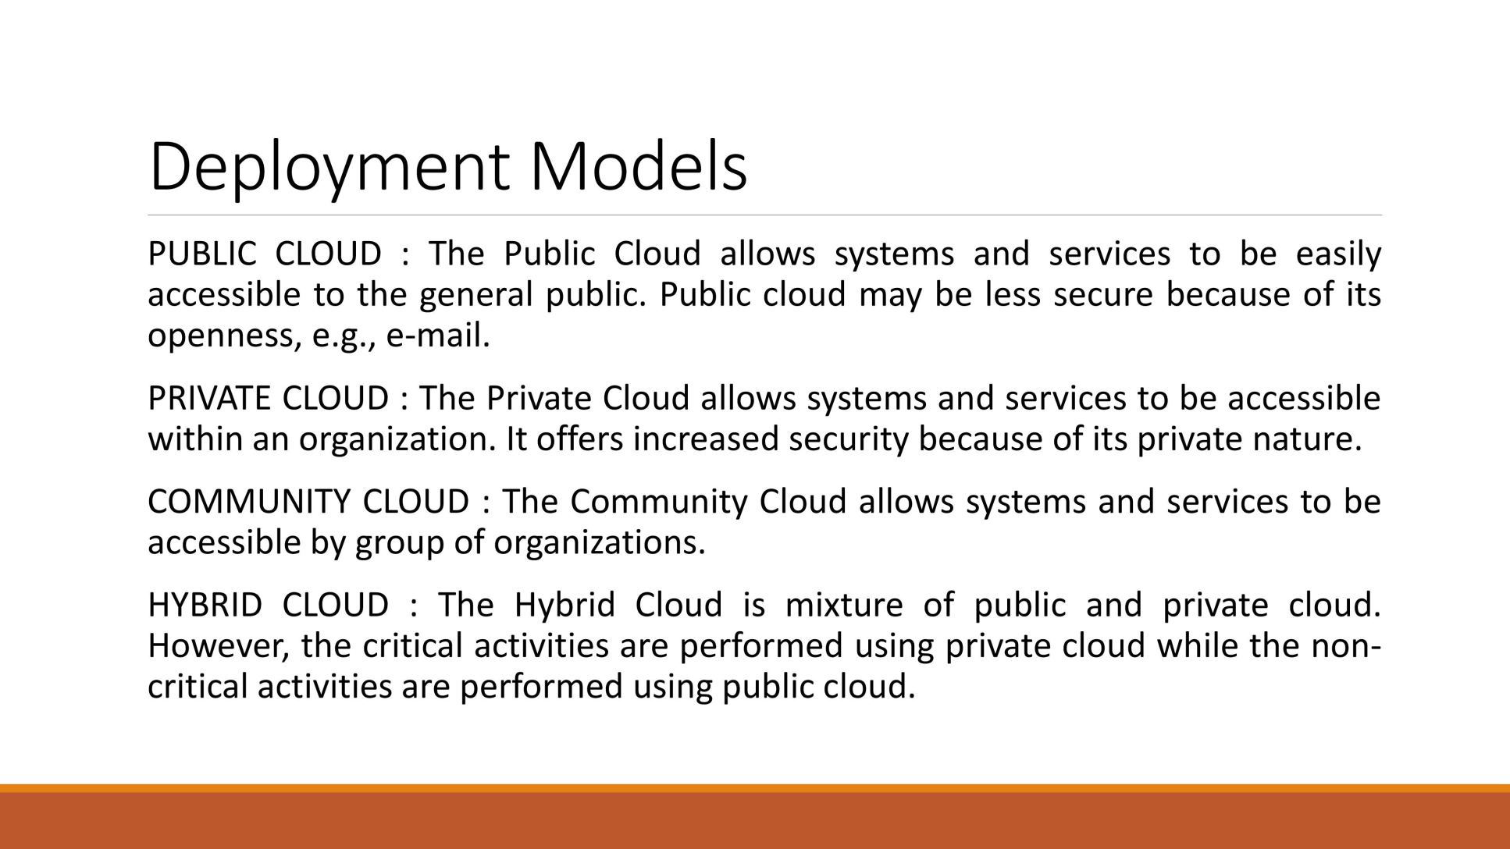
Deployment model

Slide 19
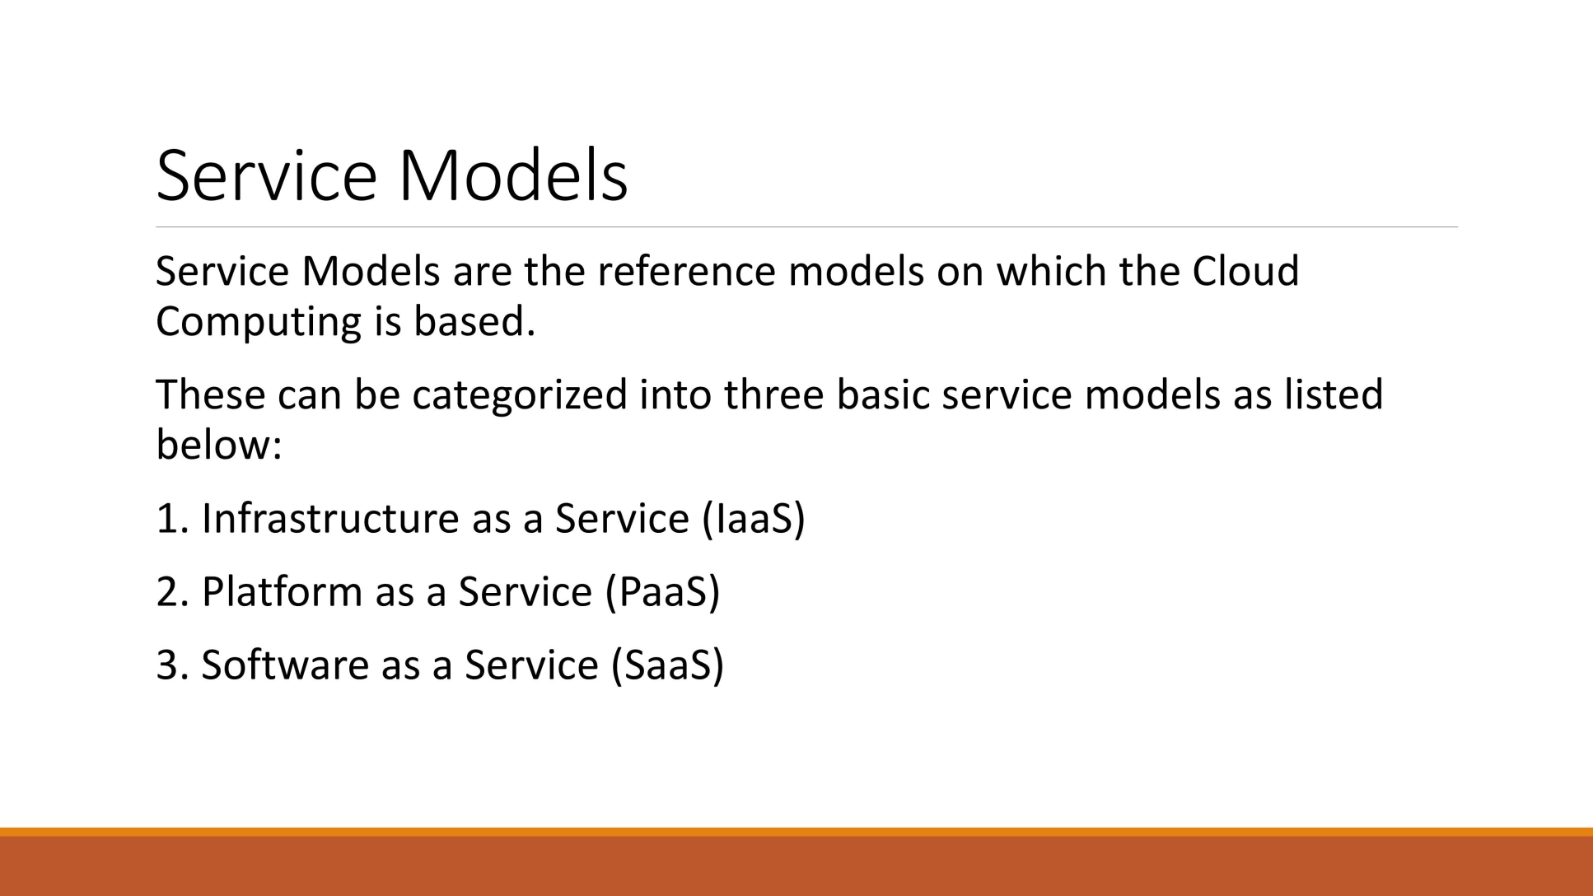
Service model

Slide 20
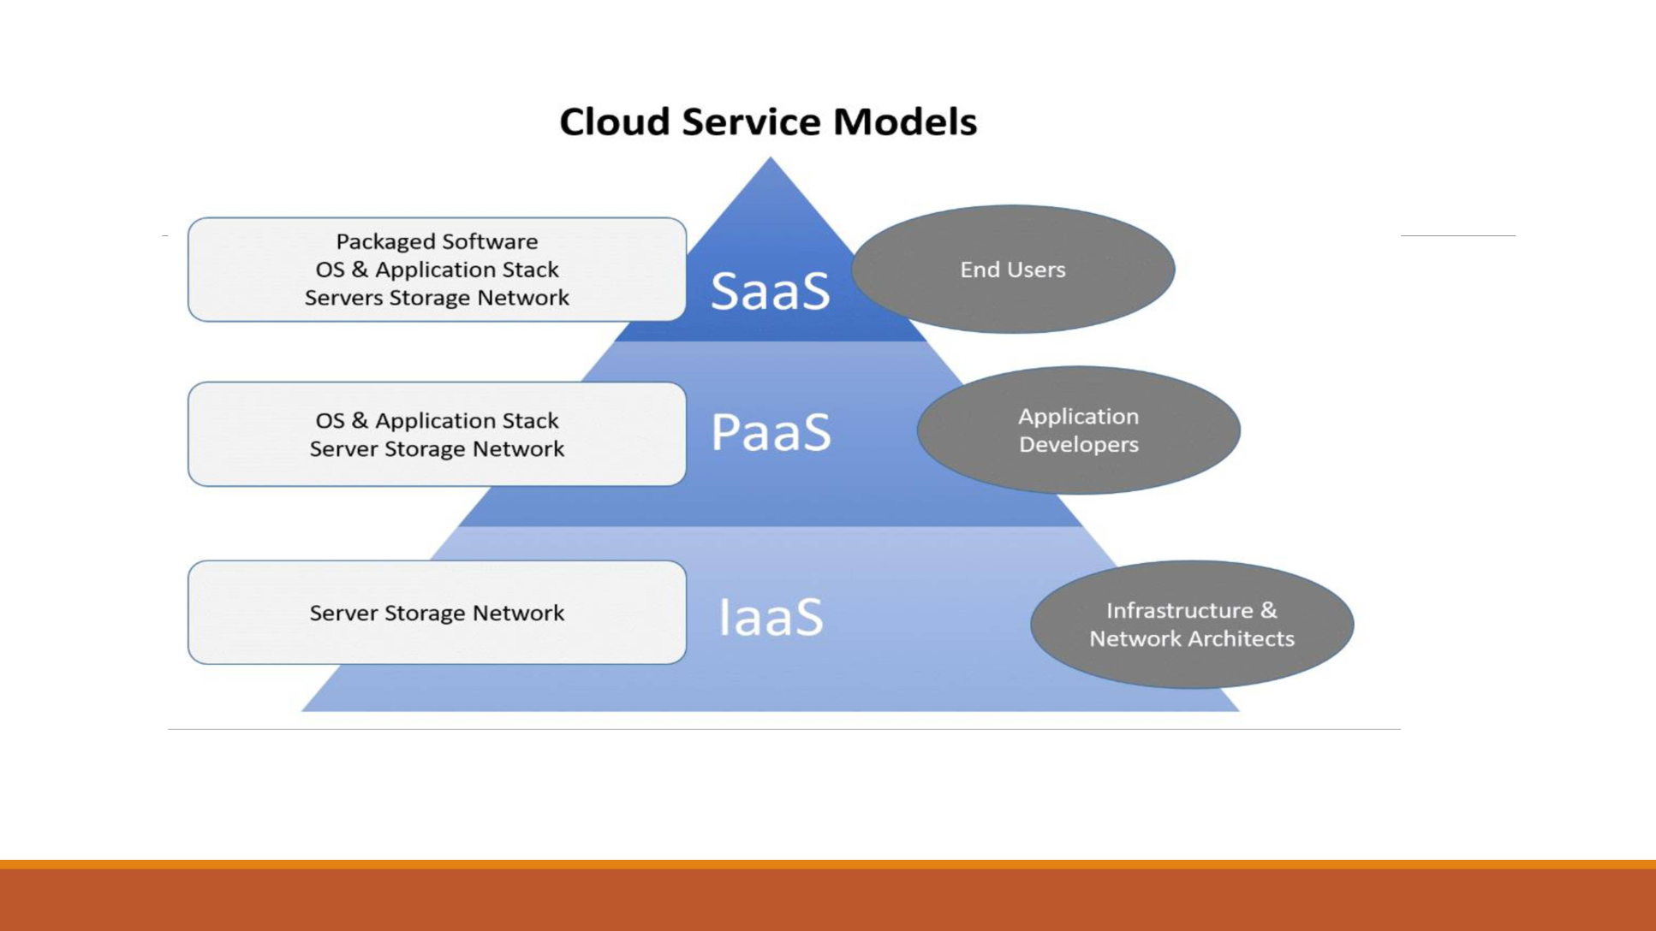

Slide 21
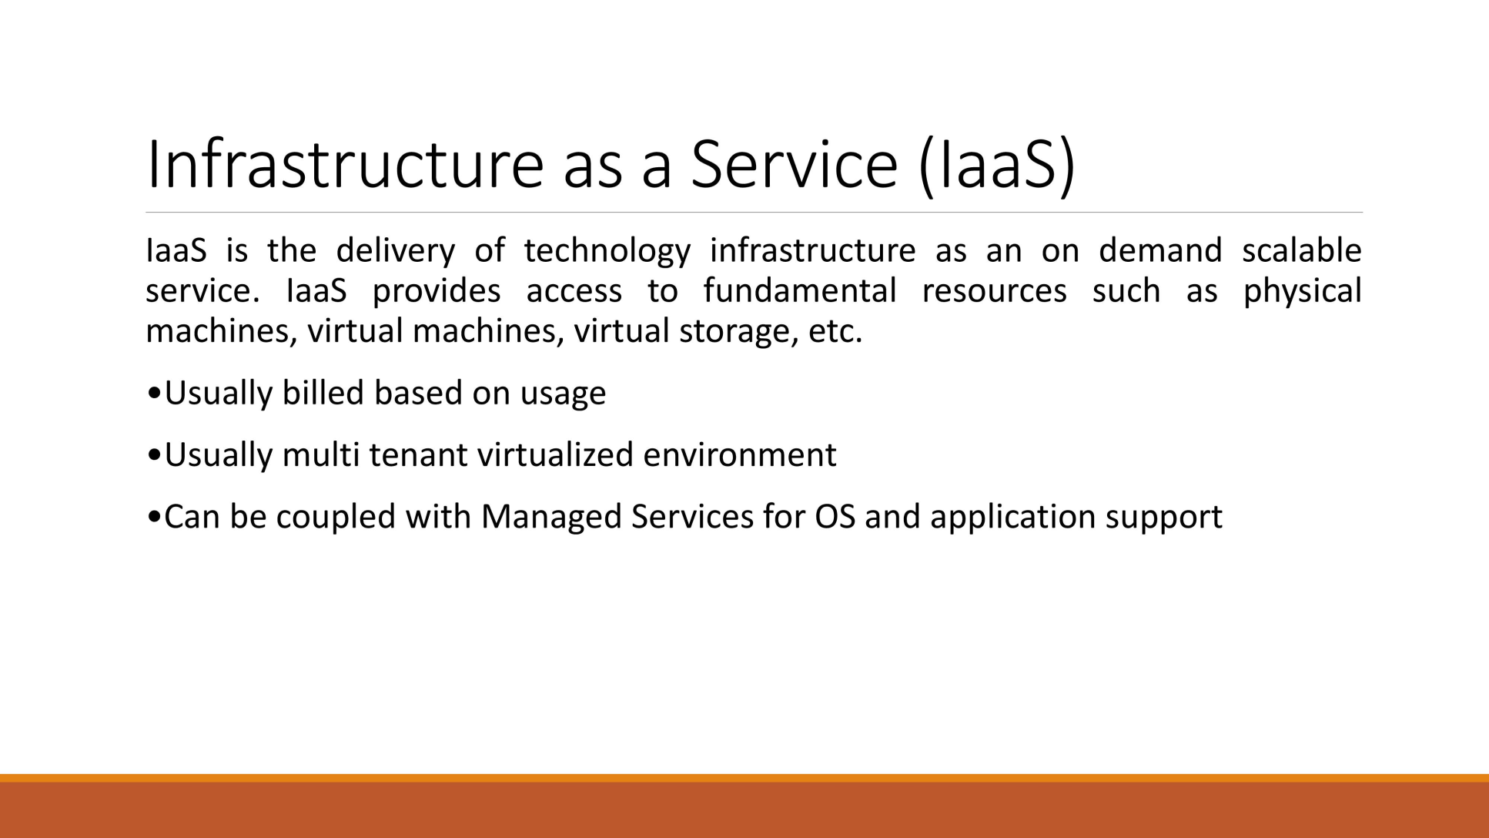
infrastructure

Slide 22
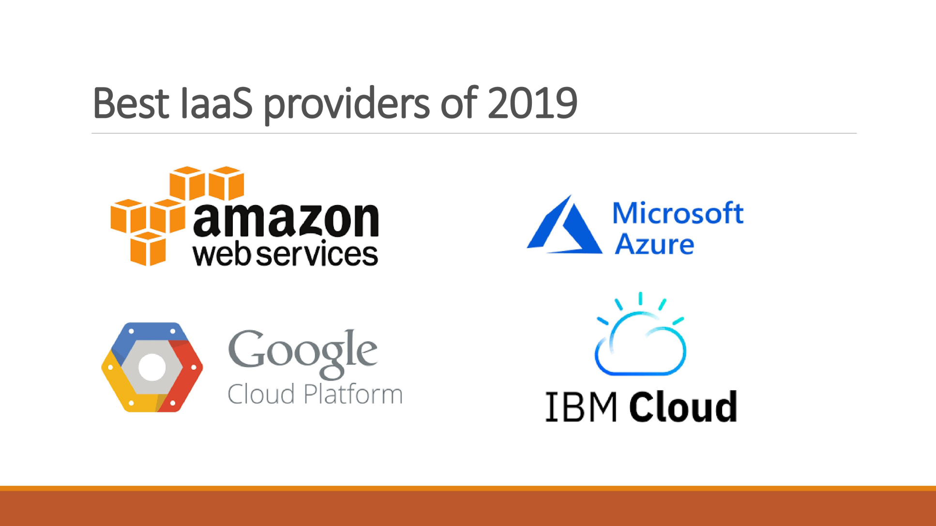

Slide 23
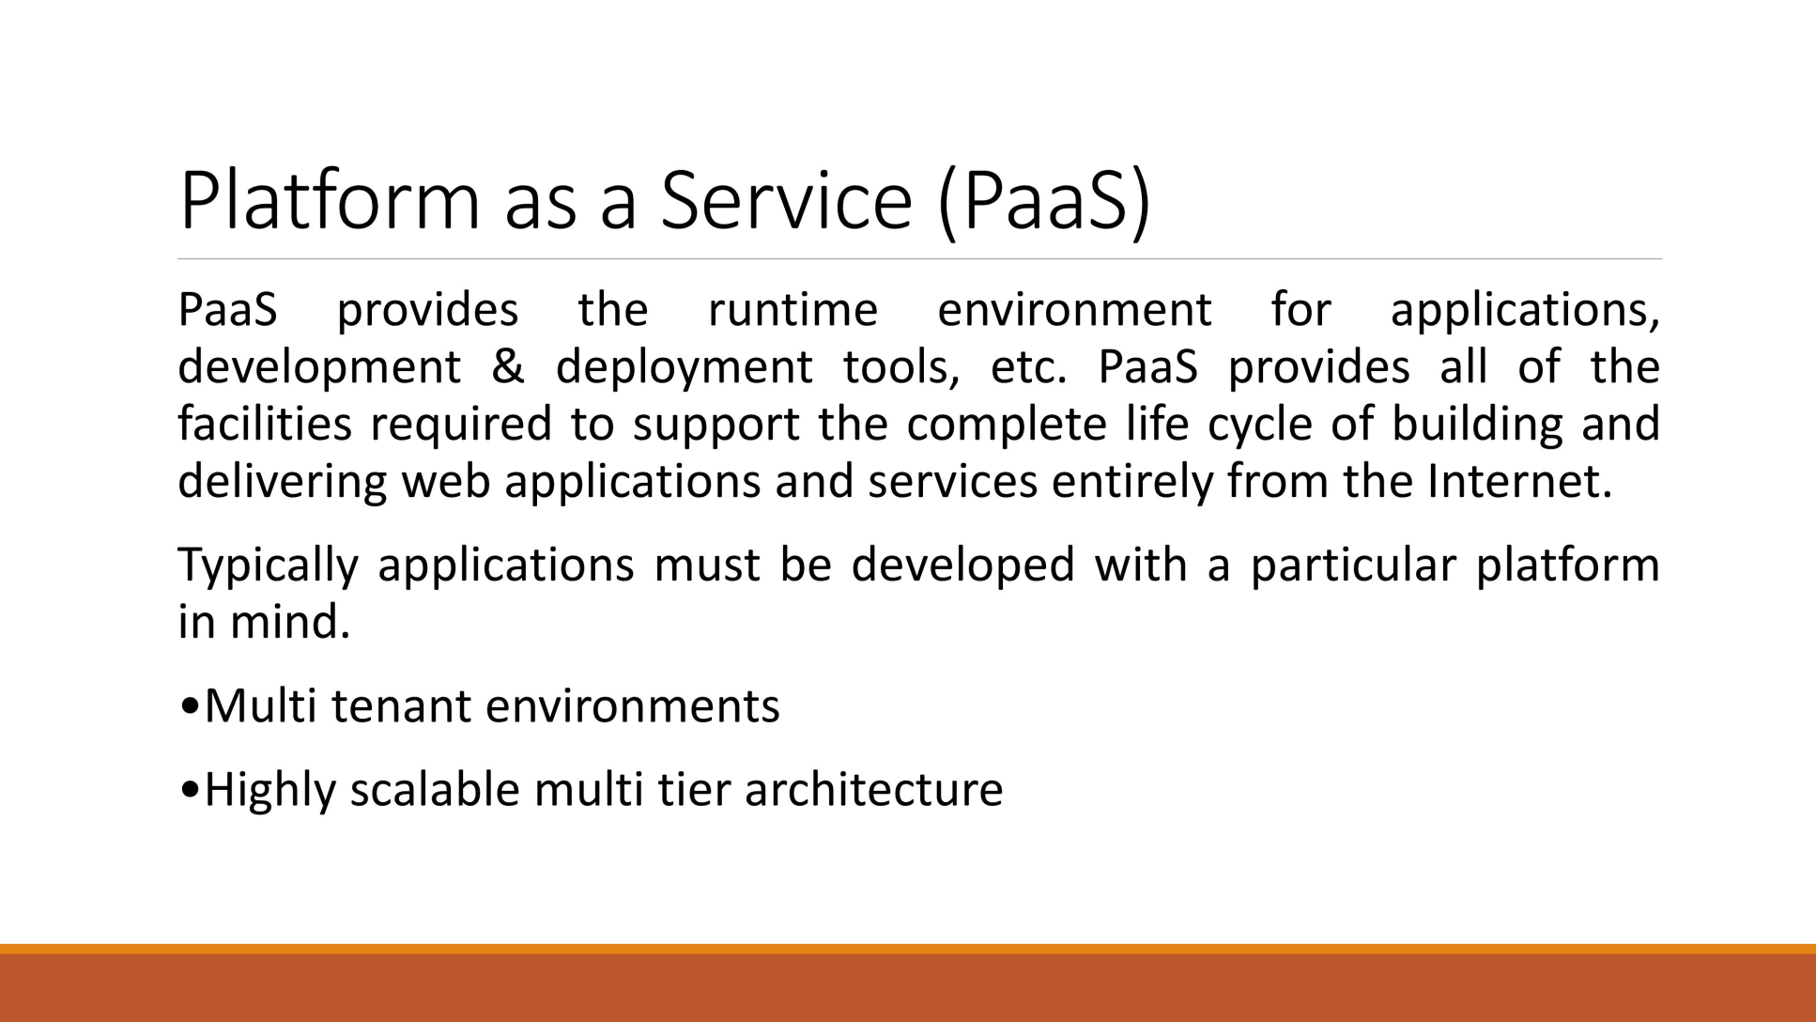

Slide 24
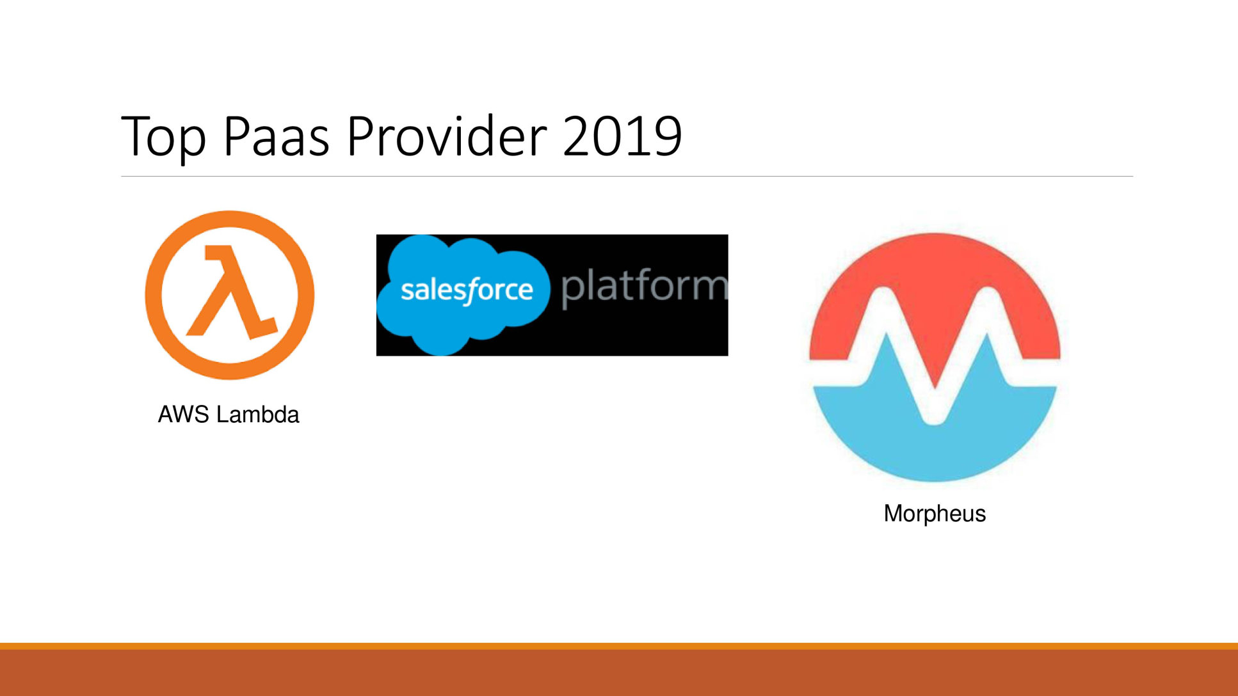

Slide 25
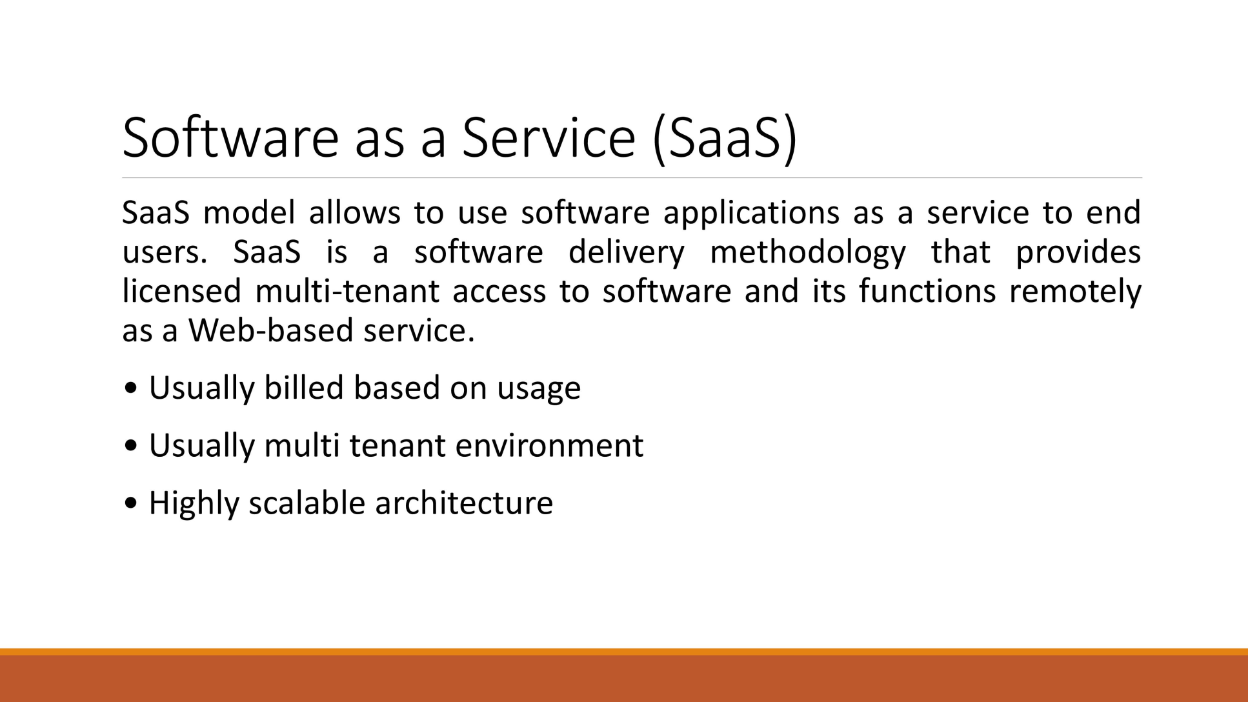

Slide 26
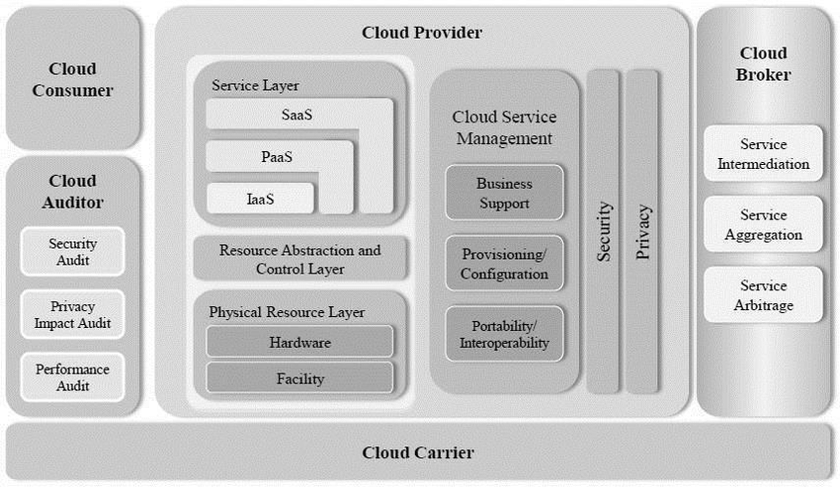
NIST Cloud Computing Reference Architecture.

Slide 27
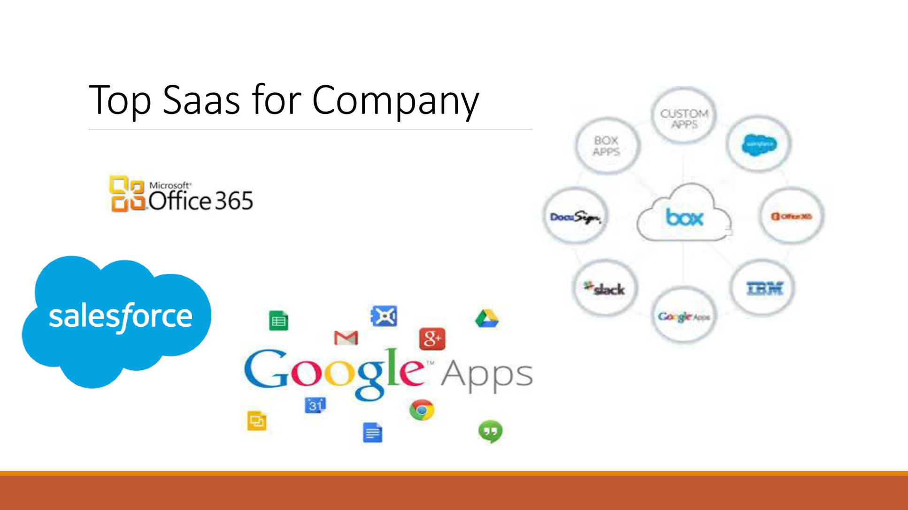

Slide 28
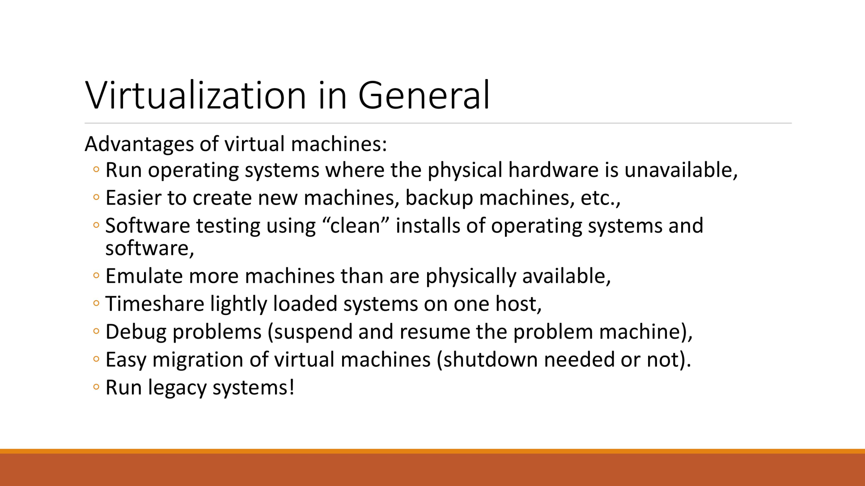
virtualization

Slide 29
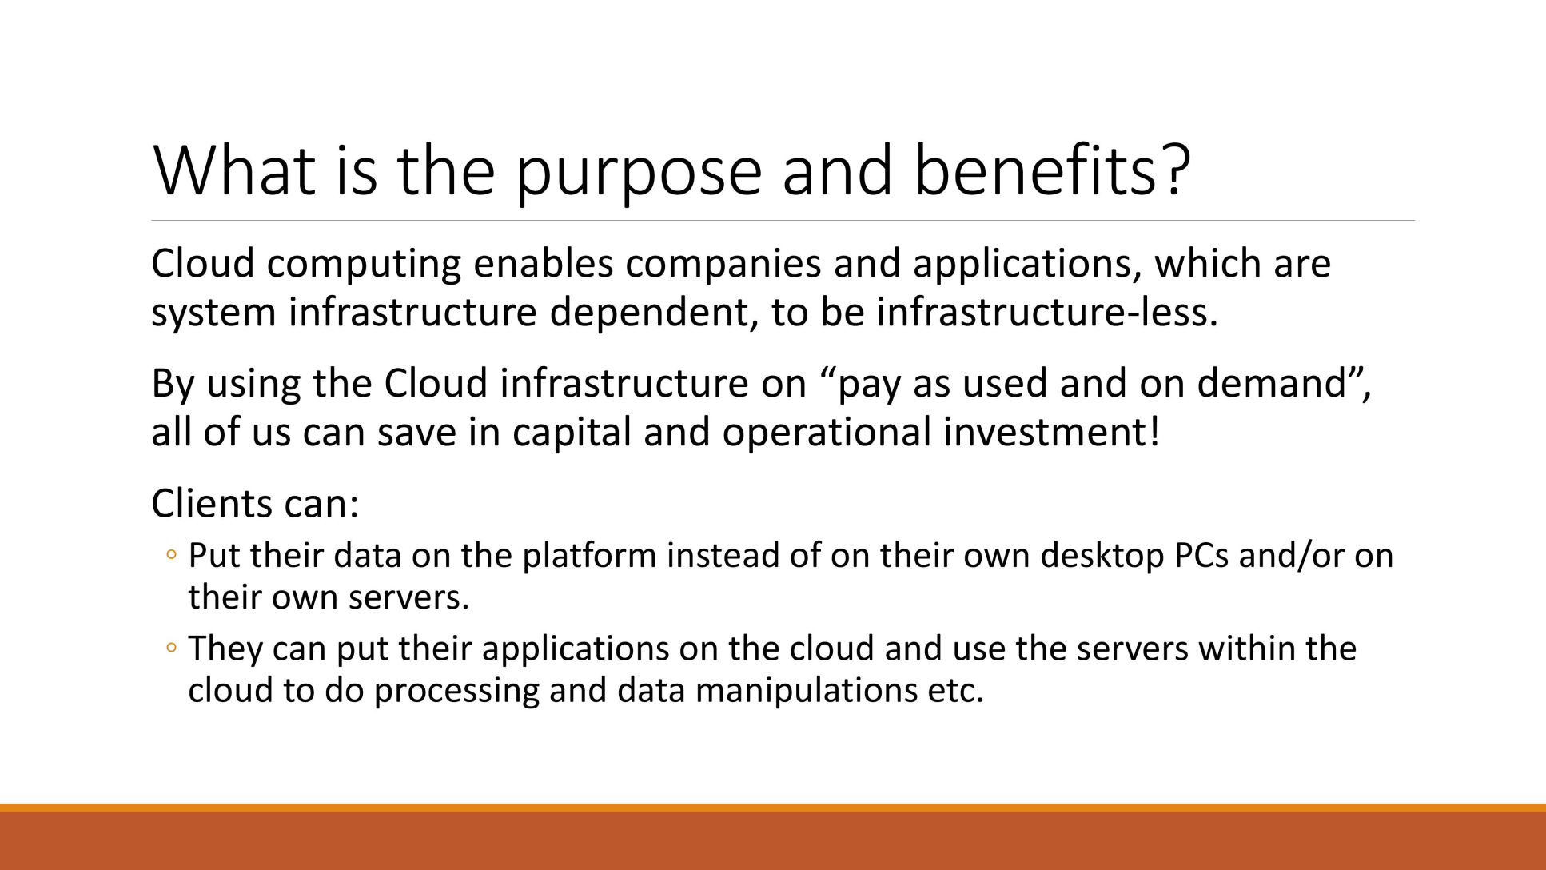
Purpose and benefits

Slide 30
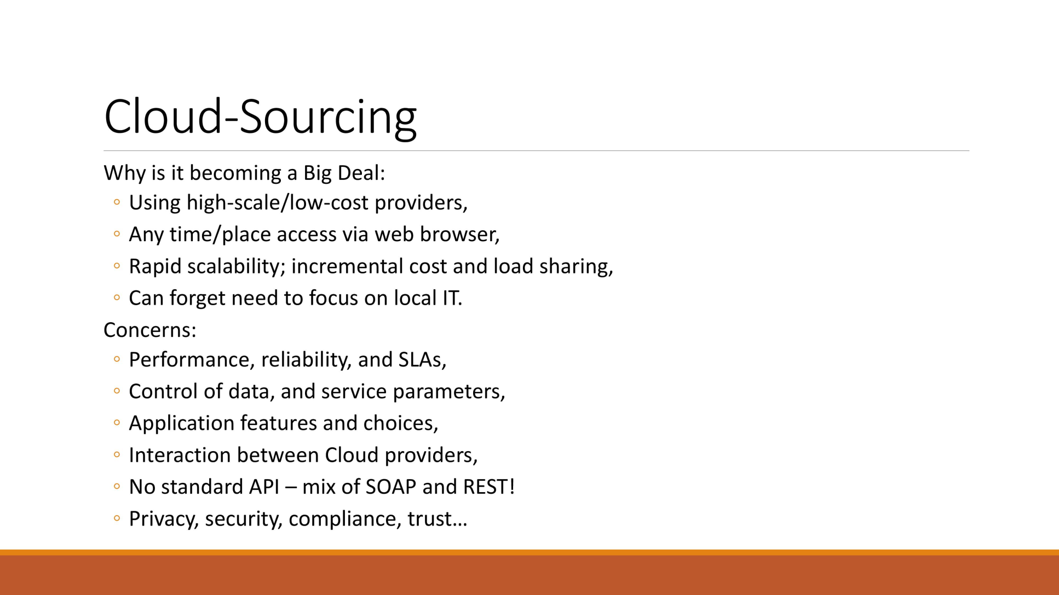
Cloud sourcing

Slide 31
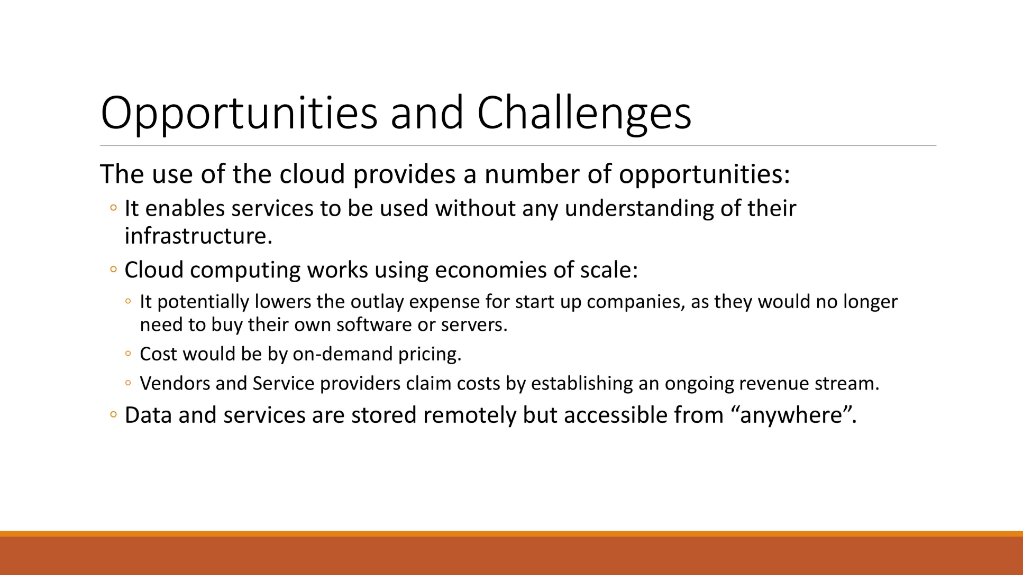
Opportunities and challenges

Slide 32
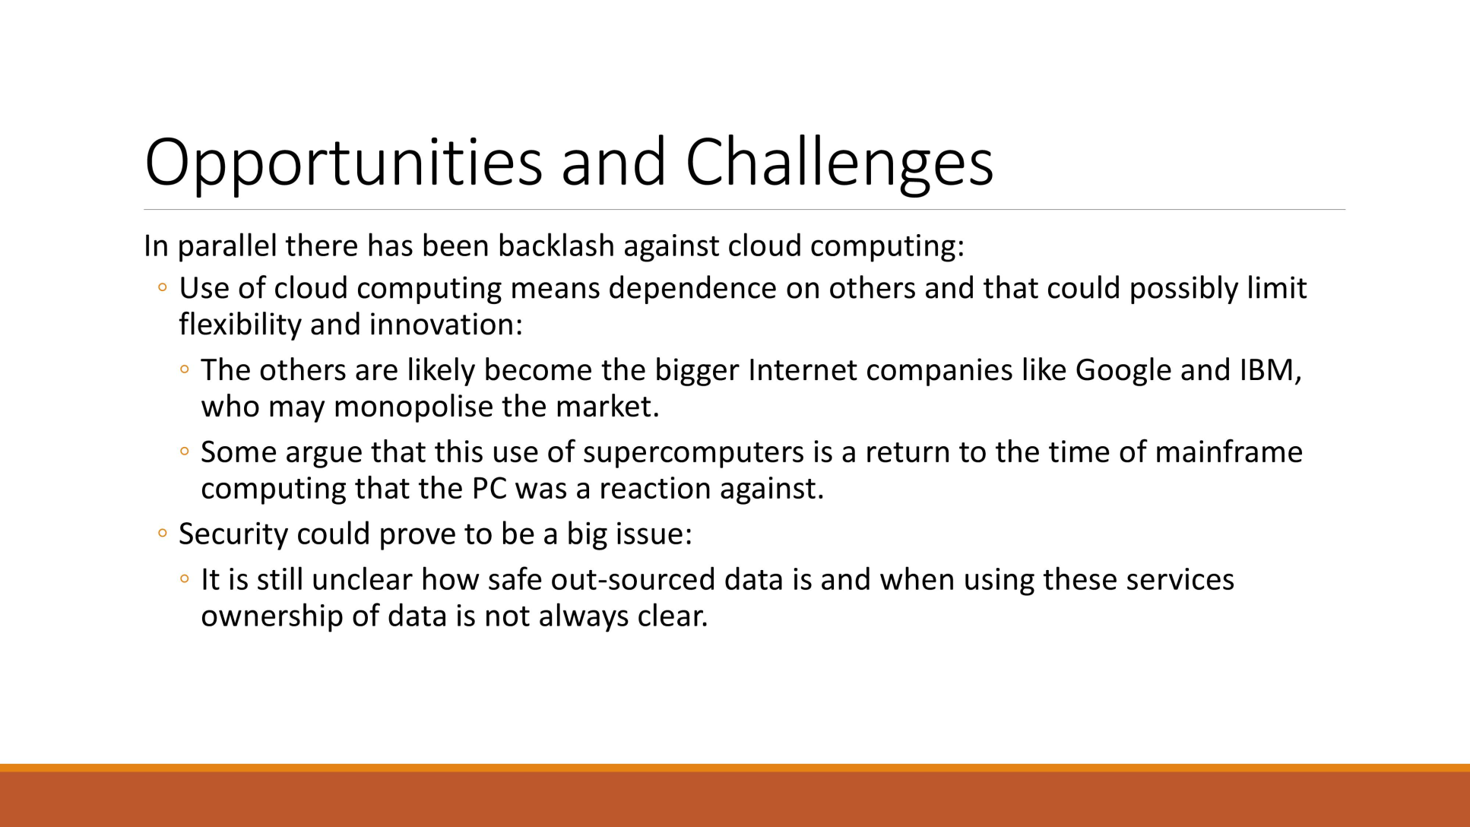
Opportunities and challenges

Slide 33
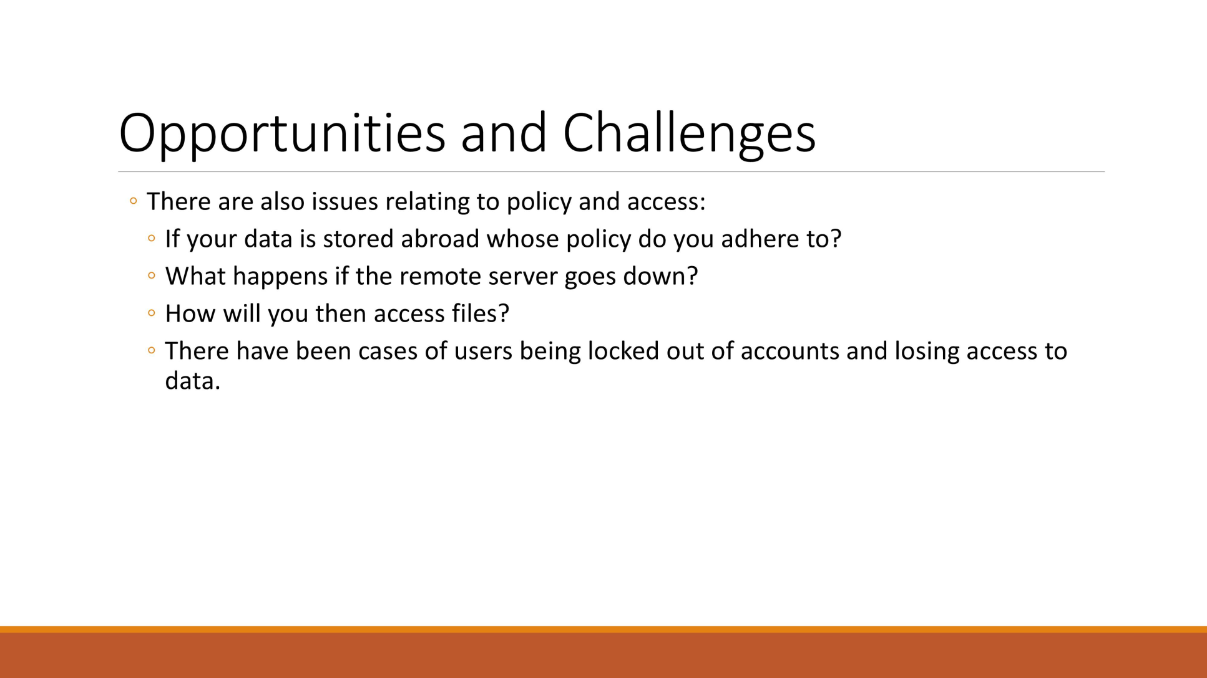
Opportunities and challenges

Slide 34
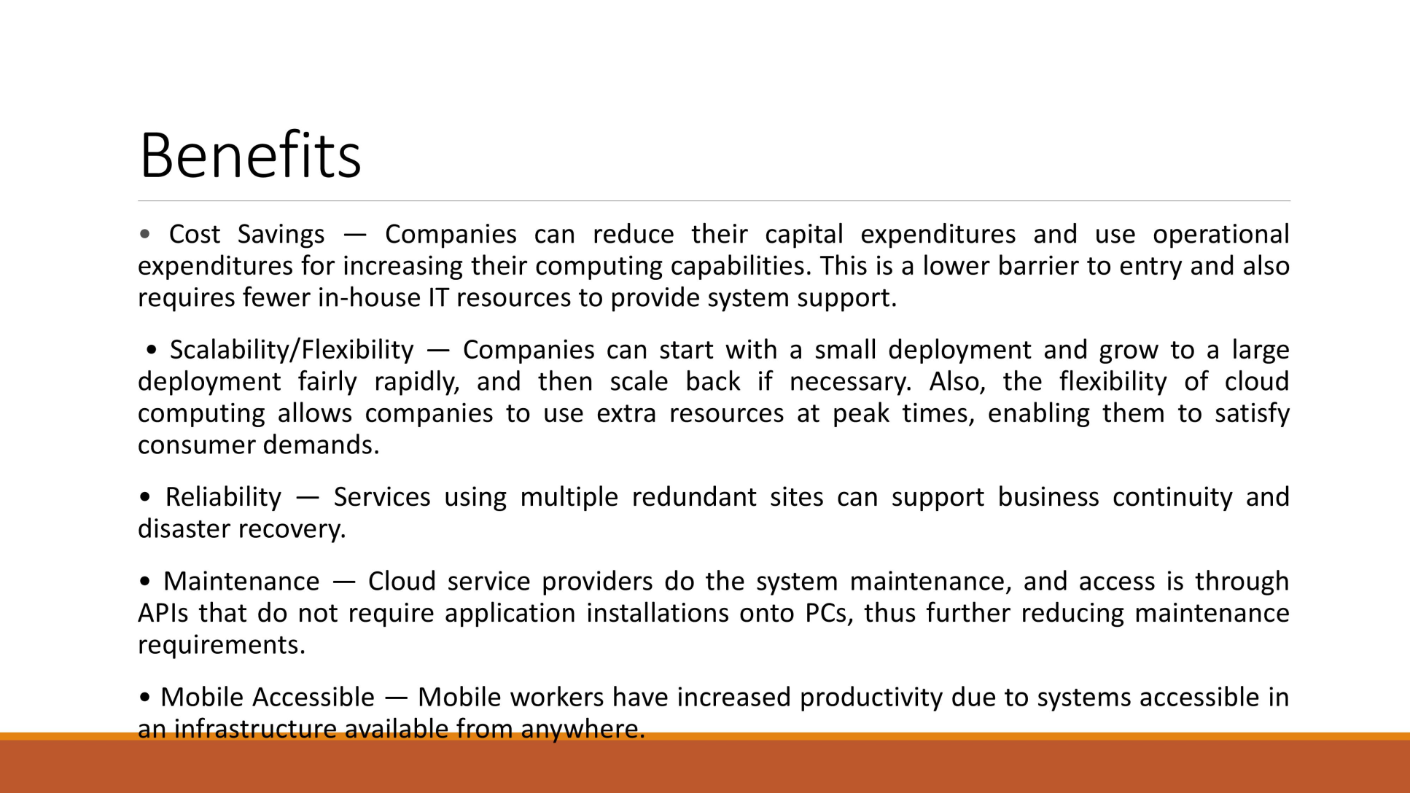

Slide 35
virtualization
Virtualization is technology that lets you create useful IT services
using resources that are traditionally bound to hardware.
It allows you to use a physical machine's full capacity
by distributing its capabilities among many users or environments.

Slide 36
Types of virtualization
Types of Virtualization
Desktop Virtualization.
Application Virtualization.
Server Virtualization.
Network Virtualization.
Storage Virtualization.

Slide 37
Why do we use virtualization
With virtualization, you can instantly access nearly limitless computing resources which allow for faster and broader business capabilities.
It also gets rid of haphazard IT rooms,
cables, and bulky hardware;
reducing your overall IT overhead
as well as management costs

Slide 38
Where is virtualization used
Storage virtualization is commonly used in storage area networks.
Server virtualization is the masking of server resources –
including the number and identity of individual physical servers, processors and operating systems -- from server users.

Slide 39
What are the features of virtualization?
Characteristics of Virtualization
Increased Security – The ability to control the execution of a guest program in a completely transparent manner opens new possibilities for delivering a secure, controlled execution environment. ...
Managed Execution – ...
Sharing – ...
Aggregation – ...
Emulation – ...
Isolation – ...
Portability –

Slide 40
Difference between cloud and virtualization
What is the difference between cloud and virtualization?
The main difference between the two concepts is that virtualization refers to the manipulation of software and hardware, while cloud computing is the consequence of this process. Practically, cloud computing is a concept created from one product, virtualization.

Slide 41
Virtualization Structures/Tools and Mechanisms
Before virtualization, the operating system manages the hardware.
After virtualization, a virtualization layer is inserted between the hardware and the operating system.
In such a case, the virtualization layer is responsible for converting portions of the real hardware into virtual hardware.
• Therefore, different operating systems such as Linux and Windows can run on the same physical machine, simultaneously.
• Depending on the position of the virtualization layer, there are several classes of VM architectures,
namely the
– hypervisor architecture,
– para-virtualization,
– host-based virtualization

Slide 42
Hypervisor
A hypervisor is a technique allowing multiple operating systems, called guests to run on a host machine.
This is also called the Virtual Machine Monitor (VMM).
Type 1: bare metal hypervisor
• sits on the bare metal computer hardware virtualization ware like the CPU, memory, etc.
• All guest operating systems are a layer above the hypervisor.
• The original CP/CMS-(Control Program/Cambridge Monitor System)
hypervisor developed by IBM was of this kind.
Type 2: hosted hypervisor
• Run over a host operating system.
• Hypervisor is the second layer over the hardware.
• Guest operating systems run a layer over the hypervisor.
• The OS is usually unaware of the virtualization

Slide 43
Para virtualization
Para virtualization is an enhancement of virtualization technology
in which a guest OS is modified prior to installation inside a virtual machine (VM)
in order to allow all guest OSes within the system to share resources and successfully collaborate,
rather than attempt to emulate an entire hardware environment

Slide 44
Host based virtualization
A host-based virtualization requires additional software running on the host as a privileged task or process.
In some cases, volume management is built in to the operating system,
and in other instances it is offered as a separate product.
A physical device driver handles the volumes (LUN) logical unit number presented to the host system.

Slide 45
The XEN Architecture
Xen is an open source hypervisor program developed by Cambridge University.
Xen is a microkernel hypervisor, which separates the policy from the mechanism.
• Xen does not include any device drivers natively . It just provides a mechanism by which a guest OS can have direct access to the physical devices. • As a result, the size of the Xen hypervisor is kept rather small.
Xen provides a virtual environment located between the hardware and the OS.

Slide 46
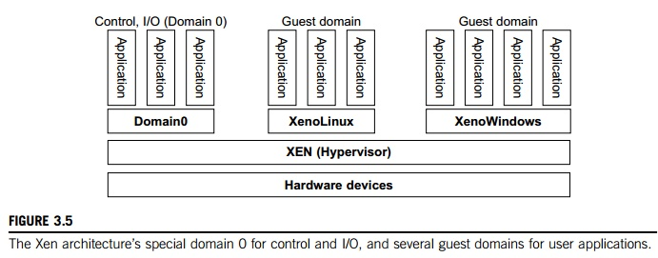
The Xen Architecture

